Slide 1
Censored demand system estimation with quaidsce
Juan Carlos Caro University of Luxembourg, Luxembourg
Grace Melo Texas A&M University, US
Jose Alberto Molina, Universidad de Zaragoza, España
Juan Carlos Salgado, Instituto Nacional de Salud Pública, México
Stata Conference 2021, August 6th
Notes:
Image https://www.jhsph.edu/research/centers-and-institutes/johns-hopkins-center-for-a-livable-future/_pdf/research/briefs/Grocery_Shopping_Shoestring.pdf
http://ageconsearch.umn.edu/record/34065/files/ae970759.pdf

Slide 2
What is the issue?
Introduction
Methods and Data
Results
Conclusion
Zero consumption is very common in household expenditure data.
Failure to account for censoring can bias demand elasticity estimates, which are key for policy simulation.
Methods to address censoring in systems of equations have been proposed based on a generalization of Amemiya’s model (1974).
Current Stata user-written commands quaids (Poi, 2012) and aidsills (Lecocq and Robin, 2015) do not address censoring.
We proposed quaidsce, building upon quaids to account for censoring using the two-step estimation approach proposed by Shonkwiler and Yen (1999).
Notes:
one out of every 11 deaths in Chile is linked to obesity
5 out of every 10 children are overweight
0.5% PIB Es así que los gastos en obesidad crecerán desde 0,5% del PIB al 2016 a 1,6% al 2030
http://www.saludpublica.uchile.cl/noticias/128966/a-2030-se-estiman-14780-muertes-a-causa-de-sobrepeso-y-obesidad

Slide 3
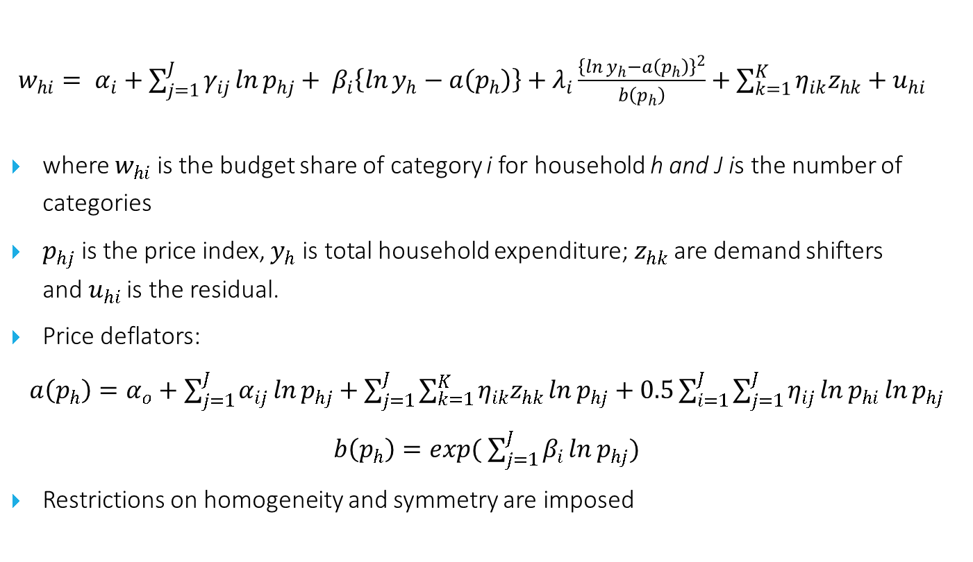
Quadratic Almost Ideal Demand System
Introduction
Methods and Data
Results
Conclusion
$w_{hi}= α_{i}+\sum_{j=1}^{J}{γ_{ij}\ln{p_{hj}}}+ β_{i}\left\{\ln{y_{h}}−a\left(p_{h}\right)\right\}+λ_{i}\frac{{\left\{\ln{y_{h}}−a\left(p_{h}\right)\right\}}^{2}}{b\left(p_{h}\right)}+\sum_{k=1}^{K}{η_{ik}z_{hk}}+u_{hi}$
where $w_{hi}$ is the budget share of category i for household h and J is the number of categories
$p_{hj}$ is the price index, $y_{h}$ is total household expenditure;$z_{hk}$ are demand shifters and${ u}_{hi}$ is the residual.
Price deflators:
$a\left(p_{h}\right)=α_{o}+\sum_{j=1}^{J}{α_{ij}\ln{p_{hj}}}+\sum_{j=1}^{J}{\sum_{k=1}^{K}{η_{ik}z_{hk}}\ln{p_{hj}}}+0.5\sum_{i=1}^{J}{\sum_{j=1}^{J}{η_{ij}\ln{p_{hi}}\ln{p_{hj}}}}$
$b\left(p_{h}\right)=exp($ $\sum_{j=1}^{J}{β_{i}\ln{p_{hj}}})$
Restrictions on homogeneity and symmetry are imposed
Notes:
Exact Affine Stone Index
Polinomio de grado superior

Slide 4
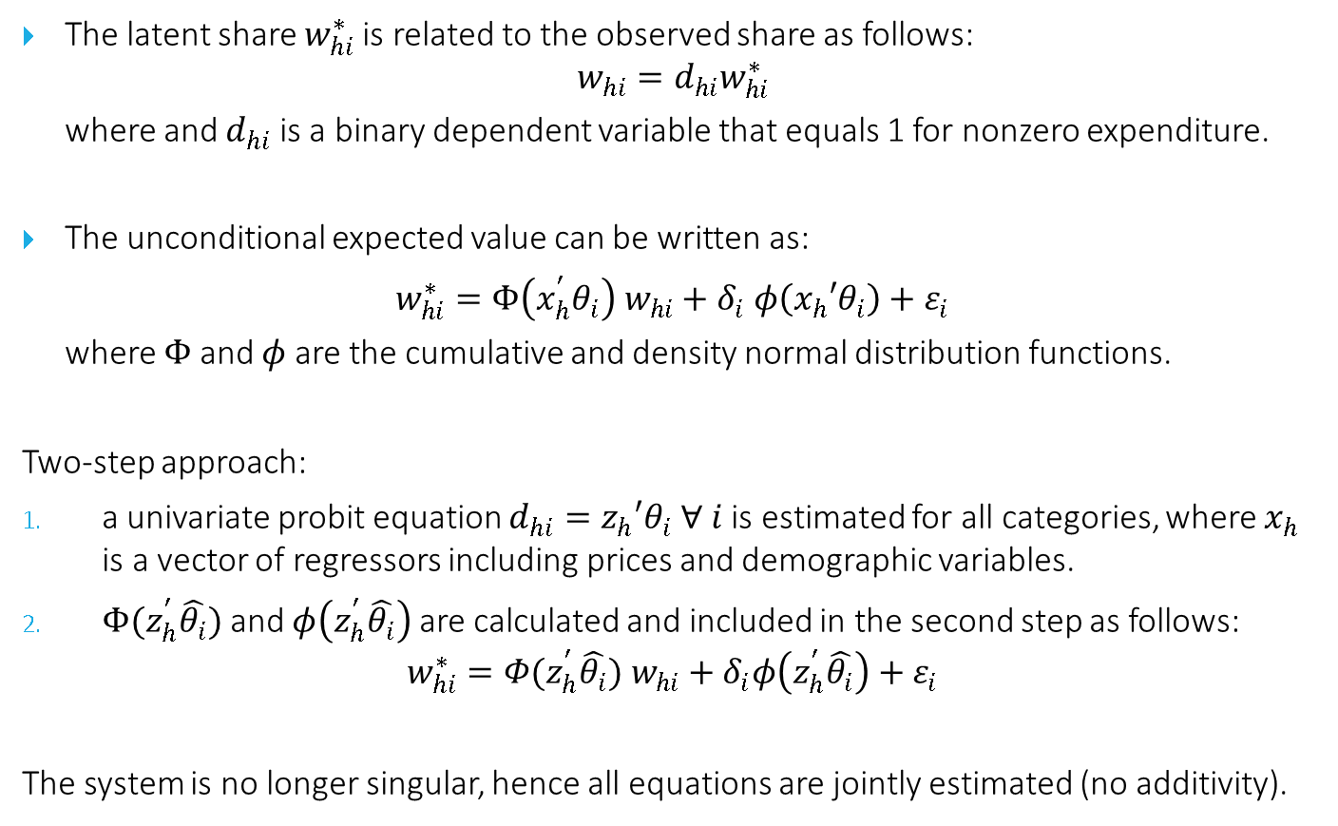
Two-step approach (SY, 1999)
Introduction
Methods and Data
Results
Conclusion
The latent share $w_{hi}^{∗}$is related to the observed share as follows:
$$w_{hi}=d_{hi}w_{hi}^{∗}$$
where and $d_{hi}$ is a binary dependent variable that equals 1 for nonzero expenditure.
The unconditional expected value can be written as:
$w_{hi}^{∗}=Φ\left(x_{h}^{′}θ_{i}\right) w_{hi}+δ_{i} φ\left(x_{h}′θ_{i}\right)+ε_{i}$
where $Φ$ and $φ$ are the cumulative and density normal distribution functions.
Two-step approach:
a univariate probit equation $d_{hi}=z_{h}′θ_{i}$ $∀ i$ is estimated for all categories, where $x_{h}$ is a vector of regressors including prices and demographic variables.
$Φ(z_{h}^{′}\hat{θ_{i}})$ and $φ\left(z_{h}^{′}\hat{θ_{i}}\right)$are calculated and included in the second step as follows:
$$w_{hi}^{∗}={Φ(z_{h}^{′}\hat{θ_{i}}) w}_{hi}+δ_{i}φ\left(z_{h}^{′}\hat{θ_{i}}\right)+ε_{i}$$
The system is no longer singular, hence all equations are jointly estimated (no additivity).
Notes:
Exact Affine Stone Index
Polinomio de grado superior

Slide 5
quaidsce syntax
Introduction
Methods and Data
Results
Conclusion
The syntax draws directly from quaids with the addition of the censoring option.
quaidsce varlist_expshares [if] [in], anot(#) {prices(varlist_prices)|lnprices(varlist_lnprices)} {expenditure(varlist_exp)|lnexpenditure(varlist_lnexp)}
[demographics(varlist_demo) noquadratic nolog nocensor vce(vcetype)]
Additional features (in progress):
- Automatically correct for expenditure endogeneity using IV
- Incorporate bootstrapped estimates for elasticities (instead of delta method)
- Manually adjust nlsur estimation method for (testing purposes)
Notes:
Exact Affine Stone Index
Polinomio de grado superior

Slide 6
An application
Introduction
Methods and Data
Results
Conclusion
Demand system estimation for food consumption using 17 categories as in Melo (forthcoming).
Cross-sectional data from the Chilean National Household Budget Survey for 2016/2017 (latest study period).
Estimates for the demand system compared with quaids (Poi, 2012).
Probit regressions based on prices (quality-adjusted unit values) and randomly generated household covariates.
Notes:
Therefore our predictions are only based on demand responses

Slide 7
Data (N=14,703 households)
Introduction
Methods and Data
Results
Conclusion
Food group | Purchase > 0 | Quantity (g) | Purchase > 0
1 Starches | 0.64 | 89.63
2 Bread | 0.97 | 197.82
3 Breakfast cereals | 0.27 | 20.25
4 Unprocessed meats | 0.89 | 146.69
5 Processed meats | 0.83 | 40.89
6 Milk & dairy desserts | 0.74 | 164.23
7 Cheese | 0.72 | 25.79
8 Fruits | 0.78 | 245.62
9 Vegetables | 0.89 | 212.15
10 Legumes & processed FVs | 0.40 | 24.07
11 Sweets | 0.61 | 36.81
12 Snacks | 0.76 | 38.30
13 Unsweetened beverages | 0.58 | 882.32
14 Sweetened beverages | 0.86 | 287.12
15 Fats & oils | 0.64 | 43.73
16 Refined Sugar | 0.33 | 63.31
17 Nonsugar sweeteners | 0.07 | 7.93
Notes:
Therefore our predictions are only based on demand responses

Slide 8
Results: delta coefficients (95% CI)
Introduction
Methods and Data
Results
Conclusion
Notes:
Negative coeff implies positive relationship between intensive and extensive margin

Slide 9
Results: alpha coefficients (95% CI)
Introduction
Methods and Data
Results
Conclusion
Notes:
Non-significant values are highlighted
only 15% of the population reporting an intake of at least five servings/day of fruits and vegetables in 2016 56. Ministerio de Salud . Encuesta Nacional de Salud 2016-2017 Primeros Resultados. Ministerio de Salud; Santiago de Chile, Chile: 2017. [(accessed on 9 June 2018)]. Available online: http://www.minsal.cl/wp-content/uploads/2017/11/ENS-2016-17_PRIMEROS-RESULTADOS.pdf/ [Google Scholar]

Slide 10
Results: beta coefficients (95% CI)
Introduction
Methods and Data
Results
Conclusion
Notes:
Non-significant values are highlighted
only 15% of the population reporting an intake of at least five servings/day of fruits and vegetables in 2016 56. Ministerio de Salud . Encuesta Nacional de Salud 2016-2017 Primeros Resultados. Ministerio de Salud; Santiago de Chile, Chile: 2017. [(accessed on 9 June 2018)]. Available online: http://www.minsal.cl/wp-content/uploads/2017/11/ENS-2016-17_PRIMEROS-RESULTADOS.pdf/ [Google Scholar]

Slide 11
Summary
Introduction
Methods and Data
Results
Conclusion
quaidsce extends over quaids to allow for censoring in consumption and expenditure data, using a two-step approach.
A practical application highlights the differences between both approaches, using data from the Chilean National Household Budget Survey 2016/2017.
Due to the non-linear approach and plug-in estimator, standard errors should be estimated via bootstrap.
Next steps
Elasticities and postestimation
Bootstrap SE
Replications
Notes:
Income growth policies will generate a higher response among low-income households
Even though this small improvement,

Slide 12
Censored demand system estimation with quaidsce
Juan Carlos Caro University of Luxembourg, Luxembourg
Grace Melo Texas A&M University, US
Jose Alberto Molina, Universidad de Zaragoza, España
Juan Carlos Salgado, Instituto Nacional de Salud Pública, México
Stata Conference 2021, August 6th
Notes:
Image https://www.jhsph.edu/research/centers-and-institutes/johns-hopkins-center-for-a-livable-future/_pdf/research/briefs/Grocery_Shopping_Shoestring.pdf
http://ageconsearch.umn.edu/record/34065/files/ae970759.pdf

